Slide 1
IEEE 802.11 Overview and Completed Amendments
Overview of the 802.11 Working Group
The IEEE 802.11 standard to date
Completed Amendments: Markets, use cases and key technologies
2025 January
Presenter:
“At lectures, symposia, seminars, or educational courses, an individual presenting information on IEEE standards shall make it clear that his or her views should be considered the personal views of that individual rather than the formal position, explanation, or interpretation of the IEEE.” IEEE-SA Standards Board Operation Manual (subclause 5.9.3)

Slide 2

IEEE Standards Association
Individual membership
Maintaining
the Standard
Initiating the
Project
6,879 individual members in 90 countries
Corporate Memberships
Gaining Final
Approval
Mobilizing
the Working Group
  187 member corporations in 23 countries
Standards Developers
Balloting the
Standard
Drafting the
Standard
  ~20,000 participants;
  all interested parties are welcome

Slide 3
The IEEE 802.11 Working Group is one of the most active WGs in 802
Focus on link and physical layers of the network stack
Leverage IETF protocols for upper layers
OSI Reference
Model
IEEE 802
Local and Metropolitan Area Networks
Standards Committee (LMSC)
Application
Presentation
Session
802.1
Higher
Layer
LAN
Protocols
802.3
CSMA/CD
Ethernet
802.11
Wireless
WLAN
802.15
Wireless
Specialty
Networks
802.16
Wireless
Broadband
Access
802.18
Radio
Regulatory
TAG
802.19
Co-existence
WG
802.21
Media
Independent
Handoff
802.22
Wireless
Regional
Area
Networks
802.24
Vertical
App.
TAG
Transport
Network
Data Link
IEEE
802
IEEE 802.11 WG Voting Members: 300+
Physical
Medium

Slide 4
Type of Groups in 802.11
Type of Group | Description
WG | Working Group
SC | Standing Committee
TG | Task Group
SG | Study Group
TIG | Topic Interest Group
AHG | Ad Hoc Group
January 2025
4

Slide 5
Development of the IEEE 802.11 Standard is ongoing since 1997
802.11-1997
802.11-1999
802.11-2003
802.11-2007
802.11-2012
802.11-2016
802.11-2020
802.11-2024
11d
Intl Roaming
11e
QoS
11k
RRM
11s
Mesh
11aa
Video Transport
11aq
Pre-association Discovery
11bc
Broadcast Services
MAC
11h
DFS & TPC
11u
WIEN
11v
WNM
11ae
QoS Mgt Frames
11ak
General Link
11i
Security
11z
TDLS
11r
Fast Roam
11ax
High Efficiency WLAN
11ai
Fast Initial Link Setup
11f
Inter AP
11w
Management Frame Security
11ay
Enhanced mmWave
11az
Enhanced Positioning
11n
High Throughput (>100 Mb/s)
11af
TV Whitespace
PHY & MAC
11ba
Wake-up Radio
11a
OFDM
54 Mb/s in 5 GHz
11g
54 Mb/s in 2.4 GHz
11ac
VHT
> 1 Gb/s in 5 GHz
11p
WAVE
11ah
Sub-1 GHz
11bb
Light Communications
11b
HR/DSSS
11 Mb/s in 2.4 GHz
11j
JP bands
11y
Contention Based Protocol
11ad
VHT
> 1 Gb/s in 60 GHz
11aj
China mmWave
11bd
Next Gen V2X
Notes:
doc.: IEEE 802.11-11/0483r0
May 2011
Bruce Kraemer (Marvell)
Page 5
The 802.11 Working Group was established in 1990. The first standard was published in 1997 (2.4GHz) supporting 1 and 2 Mbps. Subsequent amendments and revisions have increased radio performance and throughput by orders of magnitude.
The 802.11b 11Mbps standard was the first to achieve commercial success, with the announcement by Steve Jobs at MACWorld in 2001 that the MACbook would include 802.11 radios, along with the Apple Airport. PC vendors followed suit. Describe highlights of each revision.

Slide 6
Completed 802.11 technologies to meet expanding market needs and leverage new technologies - 1
802.11ah – Operating in license-exempt bands below 1 GHz (excl. TV bands)
802.11ai – Fast initial link set-up
802.11aj – Enable 802.11ad operation in the Chinese 59-64 GHz frequency band.
802.11ak – General Link
802.11aq – Pre-association Service Discovery
802.11ax – Increased throughput in 2.4, 5 (and 6) GHz bands. Increased efficiency.
802.11ay – Support for 20 Gbps in 60 GHz band.
ARC – Architecture (Ongoing discussion topics)
Notes:
Here is a list of completed amendments. ARC is an ongoing IEEE 802.11 architecture discussion group

Slide 7
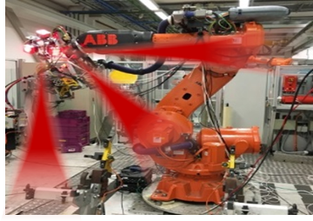
Completed 802.11 technologies to meet expanding market needs and leverage new technologies - 2
802.11az – 2nd generation positioning features.
802.11ba – Wake up radio. Low power IoT applications.
802.11bb – Light Communications
802.11bc – Enhanced Broadcast Service
802.11bd – Enhancements for Next Generation V2X
802.11be – Extremely High Throughput in 2.4, 5 and 6 GHz bands
Notes:
Here is a list of amendments currently under development.

Slide 8

802.11ah defines OFDM PHY and MAC operating in license-exempt bands below 1 GHz (excl. TV bands)
Define OFDM PHY and MAC operating in license-exempt bands below 1 GHz (excl. TV bands)
  Extended range
  Power efficiency
  Large number of devices
Potential Applications
  Internet of everything (IoT)
  Smart Grid
  Healthcare
  Smart Appliances
  Wearable consumer electronics
Monitor
January 2025
8

Slide 9
802.11ah technical features
11ah bandwidths
PHY
OFDM (FFT size 32 and 64)
New reliable MCS-10 working with larger delay spread and Doppler for outdoor
Diverse data rates:150Kbps-347Mbps
Range >1 km
MAC
Scalability up to 8191 devices per AP
    Restrict Access Window operation
    Hierarchical TIM structure
Efficient frames and transmissions
    Short frame format
    Short control/mgmt. frames
    Asymmetric & bi-directional transmissions
Reducing power consumption
    Non-TIM operation
    Target Wake Time mechanism
    Extended sleeping and listen interval
Relay Operation
Mandatory & Globally Interoperable modes optimized for sensor networking
1
150 Kbps – 4 Mbps
2
Optional higher
data rate modes for extended range -
4
8
16
5.8-78 Mbps*
Minimum 11n/ac bandwidth
20 MHz
*For 1 spatial stream and normal guard interval only. 11ah supports up to 4 spatial streams and short guard interval providing data rates up to ~347 Mbps
January 2025
9

Slide 10


802.11ai defines fast initial link set-up methods
This amendment defines mechanisms that provide IEEE 802.11 networks with fast initial link set-up methods which do not degrade the security currently offered by Robust Security Network Association (RSNA) already defined in IEEE 802.11.
The project’s primary need came from an environment where mobile users are constantly entering and leaving the coverage area of an existing extended service set (ESS).
  scale with a high number of users simultaneously entering an ESS
  minimize the time spent within the initial link set-up phase
  securely provide initial authentication.
January 2025
10

Slide 11
802.11ai technical features
STA
11i
AP
AS
DHCP
STA
11ai
AP
AS
DHCP
Beacon/Probe Resp
Authentication
Auth Req/Resp
Association
Association & IP addr
EAP
(PEAP/MSCHAPv2)
802.11ai reduces connection setup overhead by:
Improvement on scanning
  More control on scanning procedures or association attempt
  Neighbor BSS or channel information in Beacon, Probe Response and FILS Discovery frame
FILS Authentication protocol
  FILS shared key authentication with or without PFS
  Public key authentication method with PFS
Higher Layer Setup during Association/Reassociation
  Higher Layer Protocol encapsulation
  FILS IP configuration
EAPOL Key
DHCP
January 2025

Slide 12
802.11aj defines modifications to 802.11ad to enable operation in the Chinese 59-64 GHz frequency band
This amendment defines modifications to the IEEE P802.11ad Physical (PHY) layer and the Medium Access Control (MAC) layer to enable operation in the Chinese 59-64 GHz frequency band.
The amendment maintains backward compatibility with 802.11ad when it operates in the 59-64 GHz frequency band.
The amendment also defines modifications to the PHY and MAC layers to enable the operation in the Chinese 45 GHz frequency band. The amendment maintains the 802.11 user experience.
January 2025
12

Slide 13
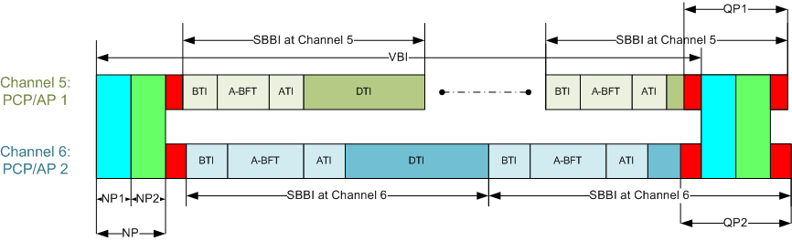
802.11aj technical features
11aj considers the following:
Link Budget Analysis for 40-50 GHz Indoor Usage
Multi-Carrier Training Field for OFDM Transmission in the 45GHz
Packet Encoding Solution for 45GHz
A Proposed frame structure is as follows
January 2025

Slide 14
802.11ak enables an 802.11 connection to be used as a through link in a general network
This amendment enables an 802.11 connection to be used as a through link in a general network, not just as a connection to an end station at the edge of a network.
Fully general mixed 802.11 and wired plug and play in the home.
Data Center top-of-rack to top-of-rack connections for overflow traffic.
Industrial and Enterprise network use.
January 2025
14

Slide 15
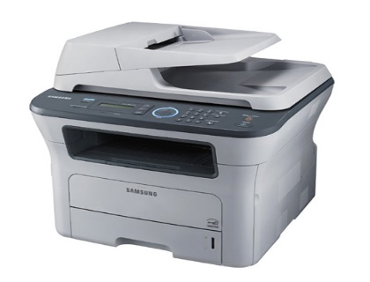



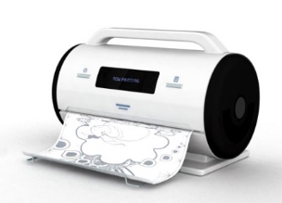
802.11aq enables the delivery of pre-association Service Discovery information
A typical use case is printer discovery in a hotel
Pre-association protocol designed to discover services on a WLAN
January 2025
15

Slide 16
802.11aq technical features
Container MAC protocol to carry upper layer service discovery protocols (e.g. UPnP, Bonjour)
Provisioning and configuration of services in the access point
  Service Transaction Proxy is a logical element connected to the access point
Universal identification of services
  Using a hash name
  Provide service attributes (e.g. 3D printer capability or point of sale service)
Currently considering request/response or broadcast concept
January 2025
16

Slide 17

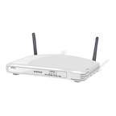
802.11ax is focused on improving performance in dense environments
Existing 802.11 WLAN systems serve dense deployments: 2019 Super bowl: 24TB* of data carried on WLAN network
802.11ax aims to further improve performance of WLAN deployments in dense scenarios
  Targeting at least 4x improvement in the per-STA throughput compared to 802.11n and 802.11ac.
  Improved efficiency through spatial (MU MIMO) and frequency (OFDMA) multiplexing.
Dense scenarios are characterized by large number of access points and large number of associated STAs deployed in geographical limited region
  e.g. a stadium or an airport.
  * https://www.extremenetworks.com/resources/slideshare/wi-fi-engagements-from-super-bowl-liii/
Access to Internet, latest airlines’ announcements, and digital media such as movies and sport events
January 2025
17
Notes:
Reference: https://www.extremenetworks.com/resources/slideshare/wi-fi-engagements-from-super-bowl-liii/
AX is the next major MAC PHY that will come to the market. Already some products R&D announced. More be shipped and certified in 2019
Primary goal of 802.11 AX is to improve the performance of wireless LANs in dense scenarios. Targeting at least 4x improvements in the throughput per client device over 802.11n and ac.
Technologies used are MU-MIMO and OFDMA

Slide 18

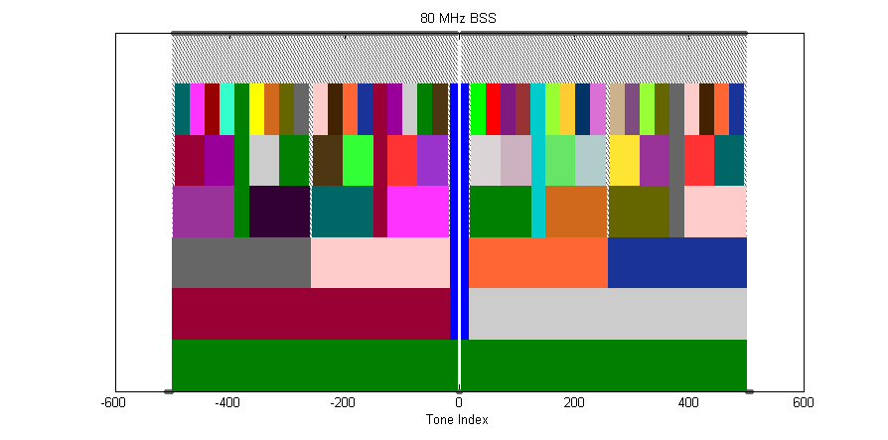
802.11ax Categories of Enhancements
Spectral Efficiency & Area Throughput
High Density
DL/UL MU-MIMO
w/ 8 clients
OFDMA
1024 QAM
25% increase
in data rate
Long OFDM
Symbol
Spatial Reuse
ac
ax
8x8 AP
2x increase
in throughput
Up to 20%
increase
in data rate
Power Saving
Outdoor / Longer range
Scheduled sleep and wake times
Extended range packet structure
20 MHz-only clients
Enhanced delay
spread protection-
long guard interval
0.8us 11ac
1.6us 11ax
3.2us 11ax
January 2025
18

Slide 19
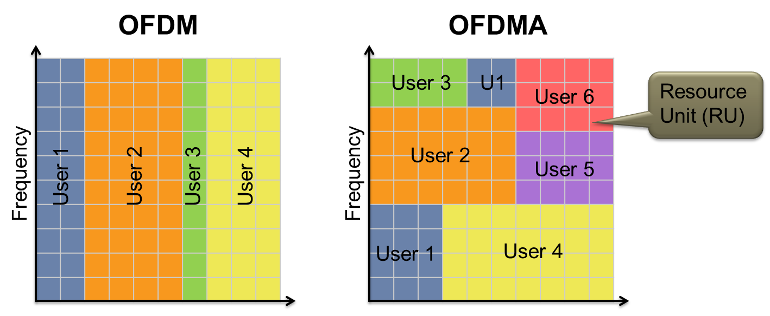
OFDMA enables further AP customization of channel use to match client and traffic demands
Increased efficiency for (high percentage of traffic) short data frames
19
Notes:
OFDMA is a radio modulation technique that provides the ability to customize at very low level the channel use to match client and traffic demands.
You can see the pictorial difference between OFDM and OFDMA.
- In OFDMA, it is possible to provide service to multiple users during the same time and frequency, especially when there are high % of traffic consists of short data frames. This provides extreme improvement in the efficiency.
OFDMA allocates subsets of frequency to specific users. OFDMA enables greater flexibility to send data to multiple users at the same time.
This technique can reduce delay and latency for traffic.

Slide 20
BSS Coloring enables additional channel re-use
All same-channel BSS block
Same-channel BSS only block on Color Match
2
2
1
5
2
1
5
2
4
1
5
2
4
1
5
3
7
4
1
5
3
7
4
6
3
7
4
6
3
7
2
6
3
7
2
6
1
5
2
6
1
5
4
1
5
2
4
3
7
4
1
5
3
7
6
3
7
4
6
6
3
7
6
20

Slide 21
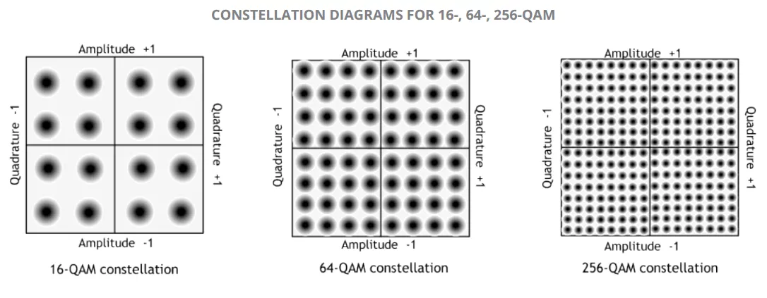
802.11ax Increases link efficiency
Increased tone density
Squeeze more tones in around DC and edge
Frequency domain
(~5% gain)
VHT
HE
FFT window
VHT
GI
DATA
GI
DATA
GI
DATA
GI
DATA
GI
DATA
…
Guard interval (GI) overhead reduced
Time domain
(~15% gain)
4 times
HE
GI
DATA
GI
DATA
…
Modulation
(~25% gain)
+ 1024-QAM
January 2025
21
Notes:
This slide shows the techniques that are used in 802.11 ax to obtain the improvements in link efficiency. They can applied in 3 domains: Frequency domain, Time domain, and Modulation.

Slide 22
UL/DL multi-user links in 802.11ax will support more efficient UL data
DL BA (STA 1)
DL BA (STA 2)
DL BA (STA n)
VHT
UL Data (STA 1)
UL Data (STA 2)
UL Data (STA n)
Trigger
Multi-STA BA
(STA 1-n)
HE
Preamble
UL Data (STA 1)
:
Data (STA n)
  In a VHT UL sequence, STAs compete for medium access and send sequentially
  In an HE UL sequence, the AP triggers simultaneous transmissions in multiple STAs
January 2025
22

Slide 23
802.11ax Data exchange sequences: Multi-user downlink
In a VHT DL MU sequence acknowledgements are serialized
In an HE DL MU sequence acknowledgements are allocated UL resources and transmitted simultaneously
Preamble
DL Data (STA 1)
BAR
BAR
:
VHT
DL Data (STA 4)
BA STA #1
BA STA #2
BA STA #4
Preamble
DL Data (STA 1)
:
HE
DL Data (STA 4)
BA STA #1
BA STA #2
: :
BA STA #n
January 2025
23

Slide 24

Uplink MU-MIMO
UL MU-MIMO was initially considered in 802.11ac, but not included due to implementation concerns
Sounding frames, data frames, etc can be grouped among multiple users to reduce overhead and increase uplink response time
8x 1SS
24

Slide 25
Various features in 802.11ax will support improved outdoor operation
  Operates in higher delay spread channels than 802.11ac:
    802.11ac GI options: 0.4 µs and 0.8 µs
    802.11ax GI options: 0.8 µs, 1.6 µs and 3.2 µs
    GI overhead mitigated with longer OFDM symbol
  Preamble includes repeated L-SIG
  Extended range preamble includes repeated HE-SIG-A
  Dual carrier modulation improves robustness in Data field
January 2025
25

Slide 26
802.11ax meets the MAC/PHY requirements for 5G Indoor Hotspot test Environment defined by IMT-2020
Analysis and simulations confirm that performance of IEEE 802.11ax MAC/PHY meet or exceed 5G requirements for the 5G Indoor Hotspot use case
Similar studies are underway for the Dense Urban test environment
 | Metric | ITU-R Evaluation Method | Minimum Requirement | 802.11ax Performance
1 | Peak data rate | Analytical | DL/UL : 20/10 Gbps | DL/UL : 20.78 Gbps [Note 1]
2 | Peak spectral efficiency | Analytical | DL/UL : 30/15 bits/s/Hz | DL/UL : 58.01 bits/s/Hz [Note 2]
3 | User experienced data rate | Analytical for single band and single layer; Simulation for multi-layer | Not applicable for Indoor Hotspot | Not applicable
4 | 5th percentile user spectral efficiency | Simulation | DL/UL : 0.3/0.21 bits/s/Hz | DL/UL : 0.45/0.52 bits/s/Hz [Note 3]
5 | Average spectral efficiency | Simulation | DL/UL : 9/6.75 bits/s/Hz/TRxP | DL/UL : 9.82/13.7 bits/s/Hz/TRxP [Note 3]
6 | Area traffic capacity | Analytical | DL : 10 Mbit/s/m² | Required DL bandwidth = 170 MHz with 3 TRxP/site. [Note 4]
7 | Mobility | Simulation | UL : 1.5 bits/s/Hz | UL : 9.4 bits/s/Hz
8 | Bandwidth | Inspection | 100 MHz, scalable | 20/40/80/80+80/160 MHz
9 | User plane latency | Analytical | DL/UL : 4 ms | DL/UL : 80 us [Note 5]
26

Slide 27
802.11ay is defining next generation 60 GHz: increased throughput and range
20Gbps+ rates are defined
License- Exempt bands above 45Gbps
Completion in 2020; First chipsets announced
Use Cases:
  Ultra-Short Range
  8K UHD - Smart Home
  AR/VR and wearables
  Data Center Inter Rack connectivity
  Video / Mass-Data distribution
  Mobile Offloading and MBO
  Mobile Fronthauling
  Wireless Backhauling (w. multi-hop)
  Office Docking
  Fixed Wireless
Key additions :
  SU/ MU MIMO, up to 8 spatial streams
  Channel bonding
  Channel aggregation
  Non-uniform constellation modulation
  Advanced power saving features
January 2025
27

Slide 28
60 GHz Fixed Wireless Use Case: Affordable 5G Performance
“the 14 GHz of contiguous spectrum in the band offers more bandwidth than any other licensed or unlicensed mmWave band. Further, the 60 GHz band has chipsets and technology currently available on the commercial market.”
“In the U.S., unlicensed mmWave frequencies available for 5G primarily cover the band from 57 – 71 GHz, called the V-Band, or 60 GHz band. This band offers 14 GHz of contiguous spectrum, which is more than all other licensed and unlicensed bands combined7. This makes the 60 GHz band an excellent alternative to licensed mmWave frequencies for smaller providers, as it can be used to deliver 5G performance for the minimal cost of available 60 GHz infrastructure products.
https://go.siklu.com/hubfs/Content/White%20Papers/Maravedis%20Industry%20Overview:%205G%20Fixed%20Wireless%20Gigabit%20Services%20Today.pdf
https://www.fiercewireless.com/wireless/60-ghz-band-particularly-appealing-for-fixed-wireless-report
January 2025
28

Slide 29

60 GHz Mesh Backhaul Wireless Use Case: Deploying Today
“Leading Wi-Fi and wireless network solution vendor Cambium Networks announced today that they will be incorporating Facebook’s Terragraph technology into a new series of Cambium Networks 60 GHz radio products called cnWave™. The news comes as Terragraph appears to be ramping up go-to-market activities with trials underway in Hungary and most recently in Malaysia.”
“Terragraph is essentially a 60 GHz-based meshed (or multi-hop, multi-point) backhaul radio system for deployment at street level in cities.”
https://wifinowevents.com/news-and-blog/cambium-networks-to-incorporate-facebook-terragraph-tech-into-new-60-ghz-products/
January 2025
29

Slide 30
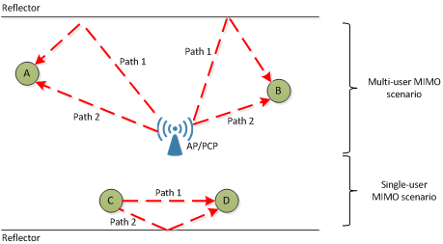
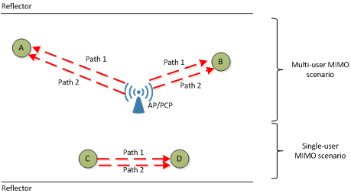
802.11ay builds on 802.11ad with MIMO and channel bonding features
Example without polarization
Channel bonding and aggregation requires new:
  Channelization
  Packet format
  Channel access mechanisms
Single User and downlink MU MIMO
  Distribute capacity across users
  Unique requirements given directionality
  Exploit antenna polarization
  Changes to the beamforming protocol
Example with polarization
January 2025
30

Slide 31
802.11ay defined channelization
January 2025
31

Slide 32



802.11az Next Generation Positioning
The P802.11az project Next Generation Positioning extends accurate IEEE Std 802.11-2016 Fine Timing Measurement capabilities
Accurate indoor Navigation (sub 1m and into the <0.1m domain).
Enables self-locating networks for easy, fast and cost efficient WLAN deployment for navigation and 6GHz AFC operation.
Secured (authenticated and private) positioning – open my car with my smartphone, position aware services (money withdrawal).
Unlock computer with a wearable device, adapt TV content to audience presence.
Location based link adaptation for home usages (connect to best AP).
Navigate in extremely dense environments (stadium/airport scenarios).
January 2025
32

Slide 33
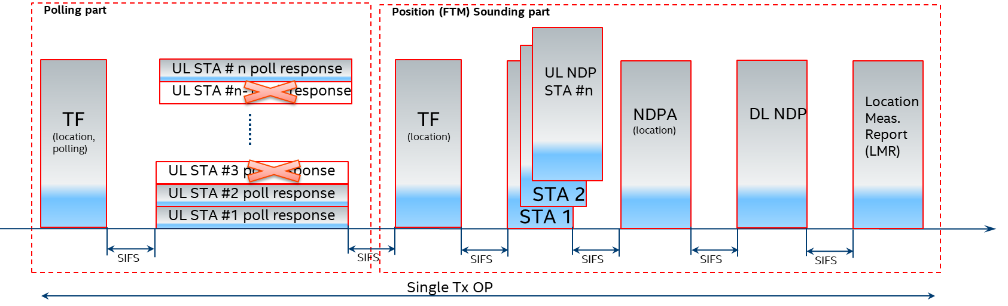
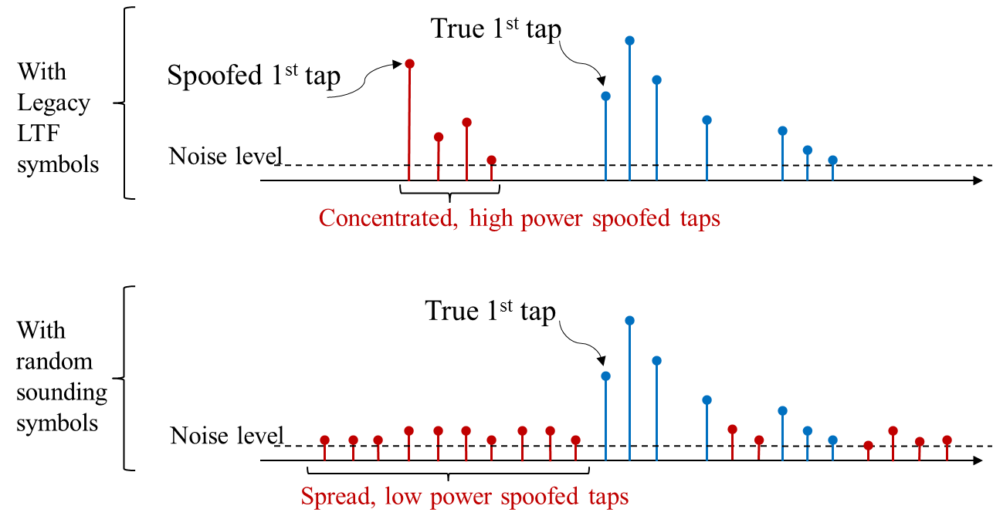
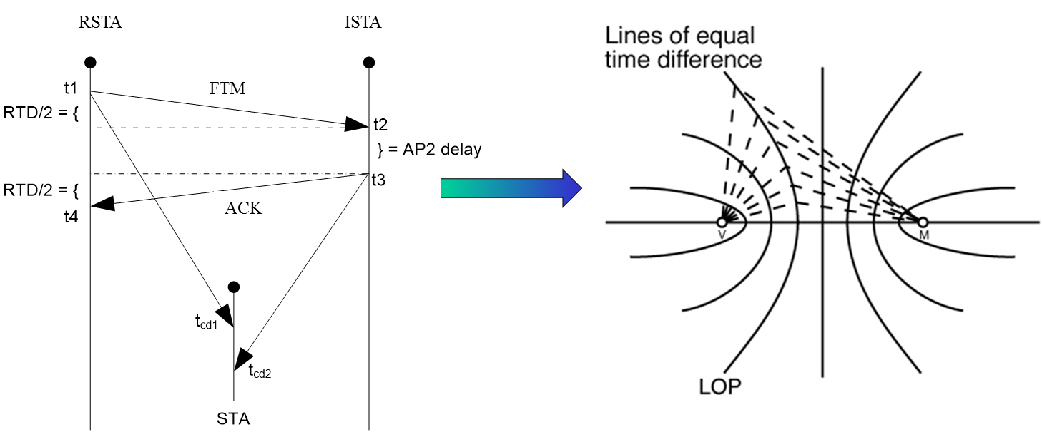
802.11az Key Radio and Positioning Techniques
Medium efficient operation via dynamic (demand dependent) measurement rate
Adaptation to next generation mainstream 802.11ax Trigger Based Operation (MIMO, Trigger Frame, NDP frame)
Authenticity and privacy and anti-spoofing mechanism via PMF in the unassociated mode and PHY level randomized measurement sequences (HE LTF sequences protection)
Improved accuracy via MIMO and larger BW available in the <7Ghz band for 11ax
MIMO enablement for measurement for improved accuracy especially for NLOS or NNLOS conditions
Passive location with fixed overhead independent of number of users
January 2025

Slide 34
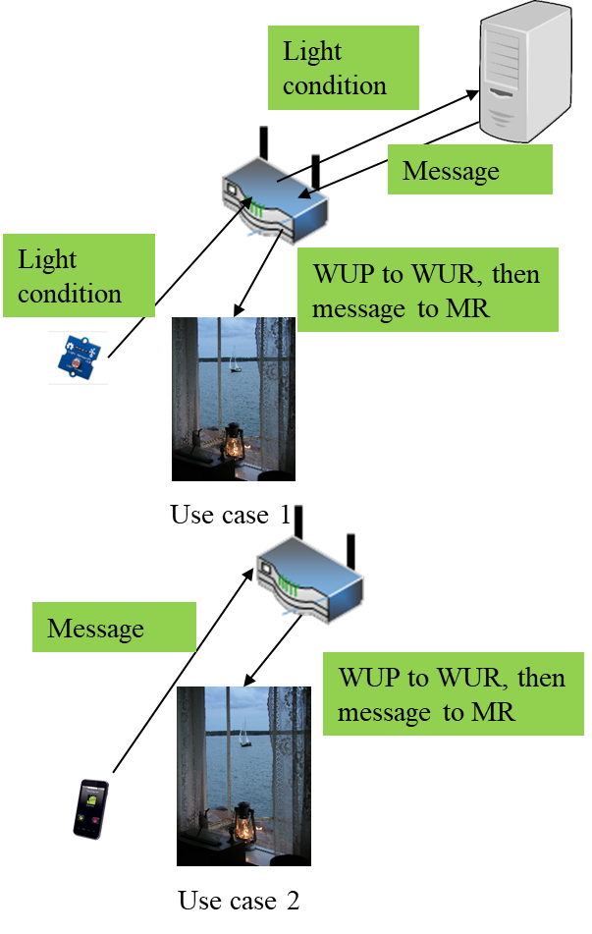
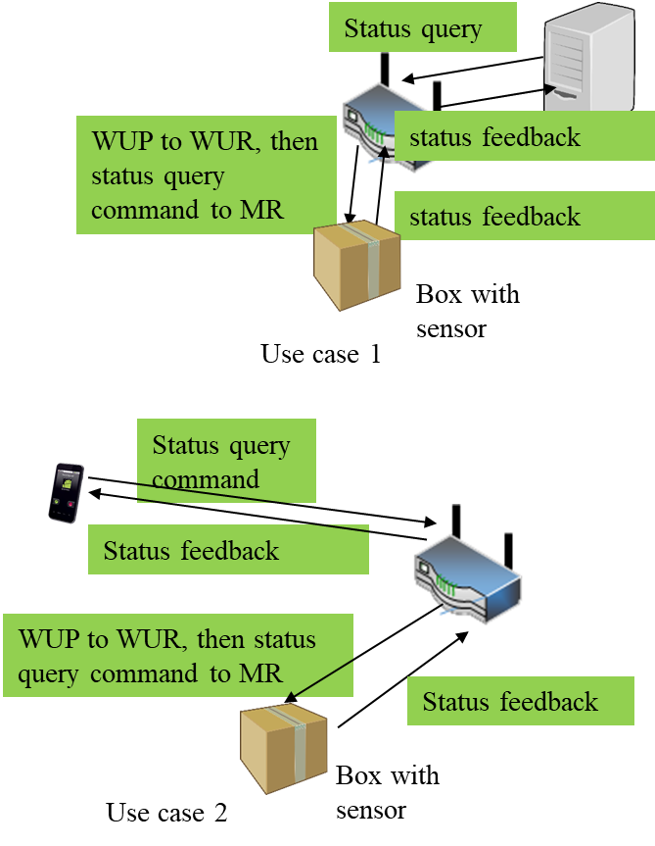
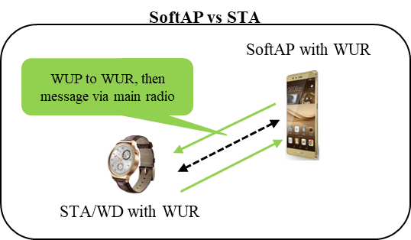
802.11ba Wake-up Radio Main Use Cases
1. Smart Home
2. Warehouse
3. Wearables
WUP: wake-up packet
WUR: wake-up receiver
MR: main radio
34

Slide 35


802.11ba improves energy efficiency of stations and maintains low latency
Internet
Internet
AP buffers data until the 802.11 station wakes up
→ Long latency
data
Buffer
data
Do you have data for me?
Buffer
Do you have data for me?
No
Do you have data for me?
802.11 radio needs to wake up periodically to receive data within a latency requirement → high power consumption of 802.11 station
No
No
Awake
Awake
802.11 station
802.11 station
Sleep
Sleep
Short sleep interval
Long sleep interval
January 2025
35
January 2025
Notes:
802.11ba focuses on improving the power efficiency of 802.11 stations, enabling longer batter life.

Slide 36
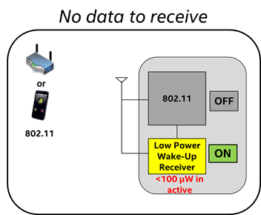
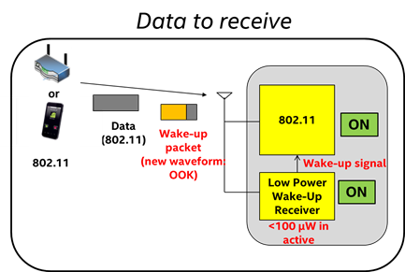
802.11ba Low-power Wake-up Receiver (LP-WUR) as Companion Radio for 802.11
Comm. Subsystem = Main radio (802.11) + LP-WUR
  Main radio (802.11): for user data transmission and reception
    Main radio is off unless there is something to transmit
    LP-WUR wakes up the main radio when there is a packet to receive
    User data is transmitted and received by the main radio
  LP-WUR: not for user data; serves as a simple “wake-up” receiver for the main radio
    LP-WUR is a simple receiver (doesn’t have a transmitter)
    Active while the main radio is off
    Target power consumption < 1 mW in the active state
      Simple modulation scheme such as On-Off-Keying (OOK)
      Narrow bandwidth (e.g. < 5 MHz)
    Target transmission range: LP-WUR = Today’s 802.11
January 2025
36
Notes:
802.11ba introduces the use a a “wake-up receiver” which can remain active at extremely low power, detecting when traffic is present for the main radio.

Slide 37
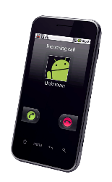

802.11ba Low Power Wake-up Radio Operation
Transmission range
or
Data
Packet
802.11 = LP-WUR
Transmitter
Receiver
802.11
802.11
802.11
802.11
ON
OFF
OFF
+
ON
802.11
Wake-up
Packet
Wake-up signal
LP-WUR
ON
Wake-up
Packet
January 2025
37

Slide 38
802.11bb Light Communications
Light Communications (LC)
  Ability to re-use existing HT, VHT and HE PHY/MAC
Use Cases:
  Industrial wireless applications
  Medical environments
  Enterprise
  Home
  Backhaul
  Vehicle to Vehicle Communication
  Underwater Communication
  Gas Pipeline Communication
Key additions :
  Uplink and downlink operations in
  800 nm to 1000 nm band
  Minimum single-link throughput
  of 10 Mb/s
  Interoperability among solid state
  light sources with different
  modulation bandwidths.
January 2025
38

Slide 39
802.11bb transports defined 5/6GHz MAC/PHY across the light channel
5/6 GHx 802.11 MAC and PHY are used as defined today
A Physical Layer Protocol Data Unit (PPDU) is converted to light using intensity modulation. At the receiver, the optical signal is converted to an electrical signal. LC systems transmit on wavelengths within the 800nm to 1000 nm band.
802.11
MAC
802.11
MAC
Existing
PHY for LC
LC
TX/RX
LC
TX/RX
Existing
PHY for LC
January 2025

Slide 40
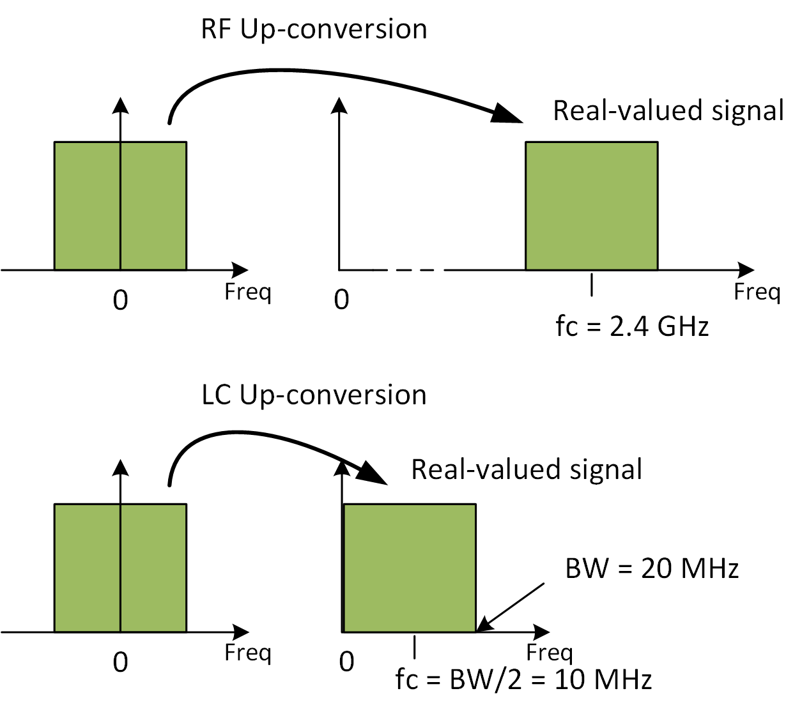
802.11bb uses light spectrum and existing WLAN capabilities
RF frontend up-converts
baseband signals onto e.g.
f_{c}= 5 GHz.
LC frontend up-converts
baseband onto low IF e.g.
f_{c}= BW/2 + Δ.
  Δ is specified in the existing draft of TGbb for various channel bandwidths.
In this manner, LC re-uses the existing HT, VHT and HE PHY/MAC specifications.
5 GHz
BW/2 + Δ MHz
January 2025

Slide 41
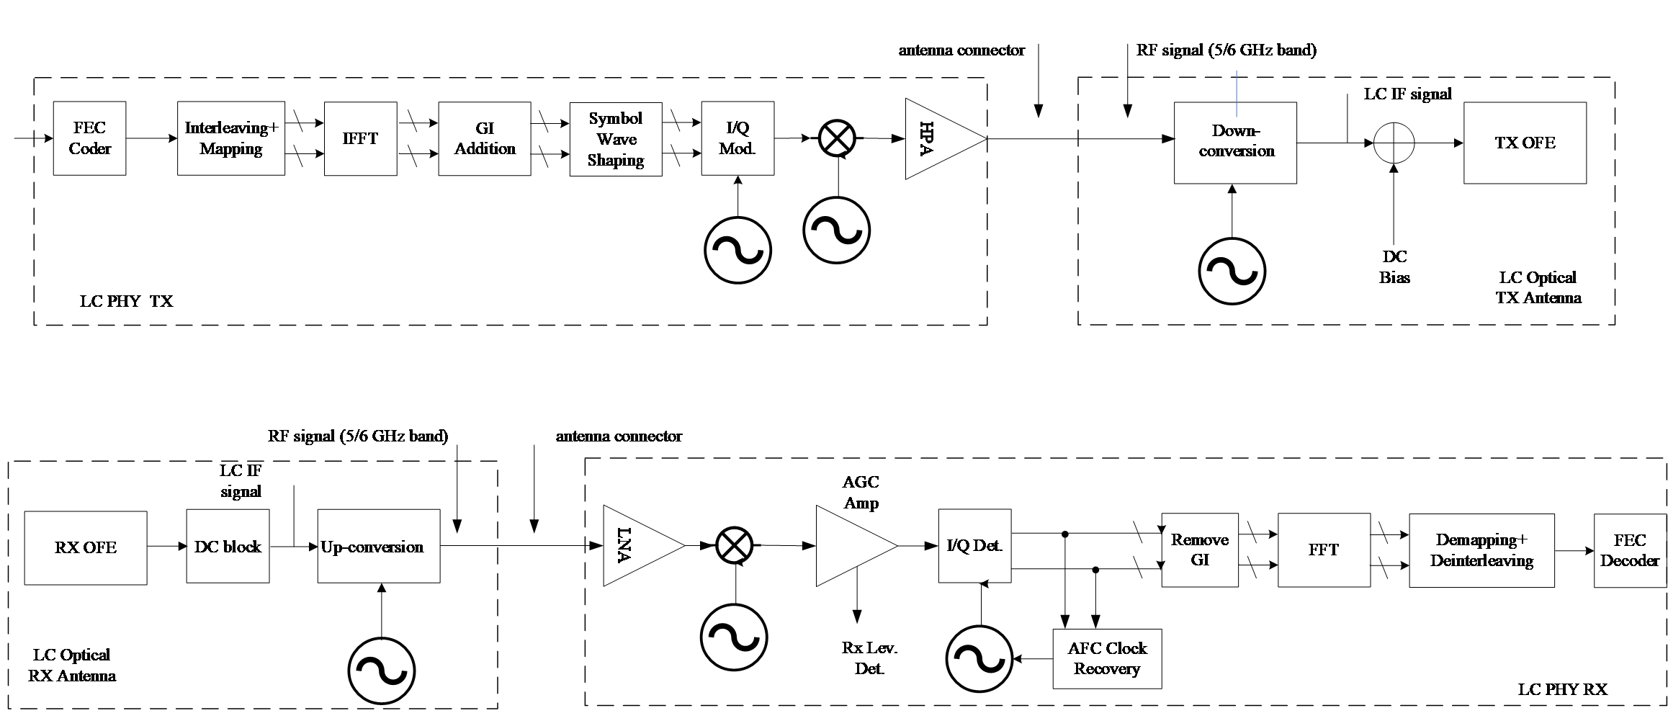
802.11bb uses light spectrum and existing 802.11 technical capabilities
Example implementation of P802.11bb using up- and down-conversion of existing 5 GHz or 6 GHz chipsets
Interfacing the LC PHY to light emitter and receiver.
January 2025

Slide 42
802.11bb usage model 1: Industrial wireless
Pre-Conditions
Devices may experience unstable radio frequency (RF) connection due to Electro-Magnetic Interference (EMI) in factories. LC is deployed to provide reliable wireless connectivity for industrial wireless networks.
Environment
All communications are within a large metal building, industrial or automated work cell. The area of these environments range from tens to thousands of square meters, equipped with industrial robot and other equipment. The environment has high levels of EMI. Lighting level of 150 lux is recommended (1500 lux for dedicated work).
Applications
Ultra-high-definition (UHD) video streaming for surveillance or production monitoring (quality control) applications, for video collaboration for team, customer, and supplier meetings. Lightly compressed Video: ~ 1Gbps, delay < 5 ms, 1x10⁻⁸ PER, 99.9% reliability. Fully connected factory—for real-time communications, application execution, and remote access.Distance between LC APs ranges from 2~20 meters.
Traffic Conditions
Both uplink and downlink traffic is using LC.
High levels of OBSS interference between LC access points (APs) expected due to very high density deployment.
Potential non-LC interference from surrounding environments such as artificial-light.
Multiple LC modules are deployed on the robot/equipment and on the ceiling/walls to provide multiple light links for a robust connectivity in case a single line-of-sight (LOS) link is blocked.
Use Case
An industrial robot is powered on and ready for operation.
Operating instructions are transmitted to the robot via LC.
The robot is working (e.g., movement) according to the instructions and provides real-time feedback information and/or video monitoring data for quality control to control center also via LC. Upon command, the robot finishes the task and is ready for the next one.
January 2025

Slide 43
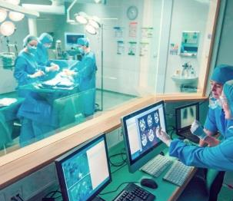

802.11bb usage model 2: Wireless access in medical environments
Pre-Conditions
IEC 60601-1-2 standard recommends the minimum separation distance between medical electrical (ME) equipment and RF wireless communications equipment (e.g., wireless local area network (WLAN)) be 30 cm to avoid performance degradation of the ME equipment. LC is deployed to ensure the performance of all ME equipment.
Environment
The size of a operating theater and MRI room ranges from 30~60 m². Multiple LC-APs are deployed on the ceiling to provide specialized illumination. The central illuminance of the operating light: 160k and 40k lux. The size of a four beds ward is about 60 m², light level: 300 lux on the bed and >100 lux between the beds and in the central area.
Applications
LC-WLAN is used to allow wireless data exchange in medical environments with ME equipment or system.
Medical multimedia and diagnostic information can be transmitted to provide telemedicine services; ME equipment can also be wirelessly controlled via LC.
Provide Intranet/ Internet access, audio or video call for doctors, nurses and patients using LC-based devices.
Traffic Conditions
No interference caused by RF radiation.
Both uplink and downlink traffic is are using LC.
High Quality of Service (QoS) and high reliability are required.
Potential non-LC interference from surrounding environments such as artificial-light.
Use Case
Doctors enter an operating theater, turn on the LC enabled LED lights and ME equipment. Doctors can interact with the remote doctors and share information using LC. ME equipment connectivity is also supported by LC. Doctors finish the treatment, then turn off the lights and medical equipment.
A patient is monitored by ME equipment which communicate with the nurses/doctors in control room via LC.
© vm
Operating theater
Hospital ward
January 2025

Slide 44
802.11bc is defining Enhanced Broadcast Services
Enhanced Broadcast Services (eBCS) defines broadcast service enhancements within an 802.11-based network.
Client end devices broadcast information to an AP, e.g. in an IoT environment, to other STAs so that any of the receiving APs act as an access node to the Internet.
January 2025

Slide 45
802.11bc Broadcast Downlink use case description
Broadcast Downlink
  Provides enhanced Broadcast Services (eBCS) of data (e.g. videos) to a large number of densely located STAs.
  These STAs may be associated, or un-associated with the AP or may be low-cost STAs that are receive only.
Topology/Architecture
Contents
Server
Network
AP
STA
STA
STA
STA
STA
January 2025

Slide 46






802.11bc Broadcast Uplink use case description
Broadcast Uplink
  Pre-configured devices (e.g. IoT) automatically connect to the end server through APs with zero setup action required.
  Alternatively, low power IoT devices that are in motion, report to their servers through APs without scanning and associating
Topology/Architecture
STA 1
AP 1
Internet
Server
AP 2
Zero Setup Sensor
STA 2
STA 1
@ t=T₁
AP 1
Internet
Server
Sensor on the move
STA 1
@ t=T₂
AP 2
January 2025

Slide 47




802.11bd defines an evolution of 802.11p for Vehicle to Anything (V2X)
802.11p is largely based on 802.11a.
802.11bd defines MAC/PHY enhancements from 802.11n, ac, ax, to provide a backwards compatible next generation V2X protocol.
Higher Throughput
  OFDM frame design
  Higher MCS, LDPC coding
  Packet aggregation
Longer Range
  Mid-amble design
  Repeated transmission mechanism
  More robust channel coding
Support for Positioning
Backward Compatibility
  Backward compatible frame format design, Version indication
Longer Range
Higher Throughput
Backwards Compatibility
Positioning
January 2025

Slide 48
802.11bd: Next Generation V2X Use Cases
5.9 GHz band mainly, and optionally 60 GHz;
Completion in 2022/2023
http://www.ieee802.org/11/Reports/tgbd_update.htm
V2X Use Cases:
  Suport all defined DSRC/802.11p use cases, including
  Basic safety message (safety, range, backward
  compatibility, fairness)
  Sensor sharing (throughput)
  Multi-channel operation (safety channel +
  other channels)
  Infrastructure applications (throughput)
  Vehicular positioning & location (LoS and
  NLoS positioning accuracy)
  Automated driving assistance (safety, throughput)
  Aerial vehicle IT application (video)
  Train to train (high speed)
  Vehicle to train (high speed, long range)
Key additions :
  Higher throughput (2x) than 802.11p
  Longer range (3dB lower sensitivity level)
  Support for positioning
  Backward compatibility with 11p
January 2025
48

Slide 49
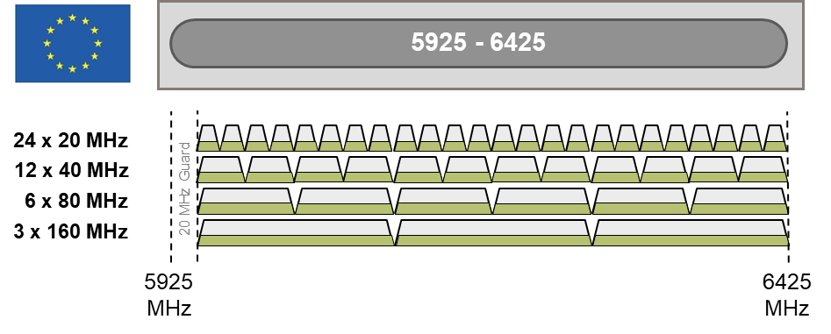


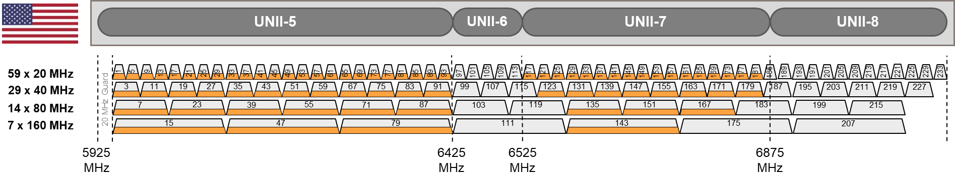
802.11be Extremely High Throughput amendment builds on 802.11ax, including 6GHz support
Use Cases:
  Home, enterprise, industrial, IoT
  Outdoor
  AR/VR, wireless gaming
  4K and 8K video streaming
  Remote office
  Cloud/edge computing
  Video calling and conferencing
Extremely High Throughput (EHT)
Operation in 2.4 GHz, 5 GHz, and 6 GHz bands
Higher throughout – Project goal of at least
30 Gbps; expect 40+Gbps with 320MHz channels,
4096 QAM
Support for low latency communications
Continued improvements in spectral efficiency
Targeted completion in 2024
January 2025
49

Slide 50
802.11be features under consideration
  Support of 320 MHz bandwidth channels, enabling extremely high throughput use cases
  More efficient utilization of non-contiguous spectrum
  Multi-band/multi-channel aggregation and operation
  MIMO protocol enhancements, enhanced sounding protocol
  Multi-AP Coordination (e.g. coordinated and joint transmission)
  Refinements of 802.11ax features: Multiple Resource Unit operation
  Target Wait Time (TWT) enhancements
  GCMP-256 support
  Adaptation to regulatory rules specific to 6 GHz spectrum
  NSEP priority access operation
January 2025

Slide 51

The ARChitecture SC (ARC) meets on an ongoing basis
It does not develop a standard or amendment
Discussion of 802.11 architecture issues for other ongoing amendments
Topics for discussion include:
  Architectural clauses and models in the standard, as questions, or needs for update or clarification arise.
  Relationships with outside groups on 802.11 architectural topics, or topics that don’t fit elsewhere, such as IETF, 802 O&A, and 802.1.
January 2025
51

Slide 52
ARC technical considerations
Models for STA architecture and related concepts, and overall system architecture, included in the Standard in clauses 4 and 5, generally.
Evolution of the models, either to consider amendments to the Standard, or as clarification is needed
Define how 802.11 technologies fit into 802, 802.1 and IETF use cases.
January 2025
52

Slide 53
Thank You
Questions
January 2025

